Slide 1
Elastic Search
What is a Elastic Search?
Elastic search is a distributed ,open source search and analytics engine,designed for horizontal scalability, reliability and easy management.
This course starts at the beginner’s level.

Slide 2
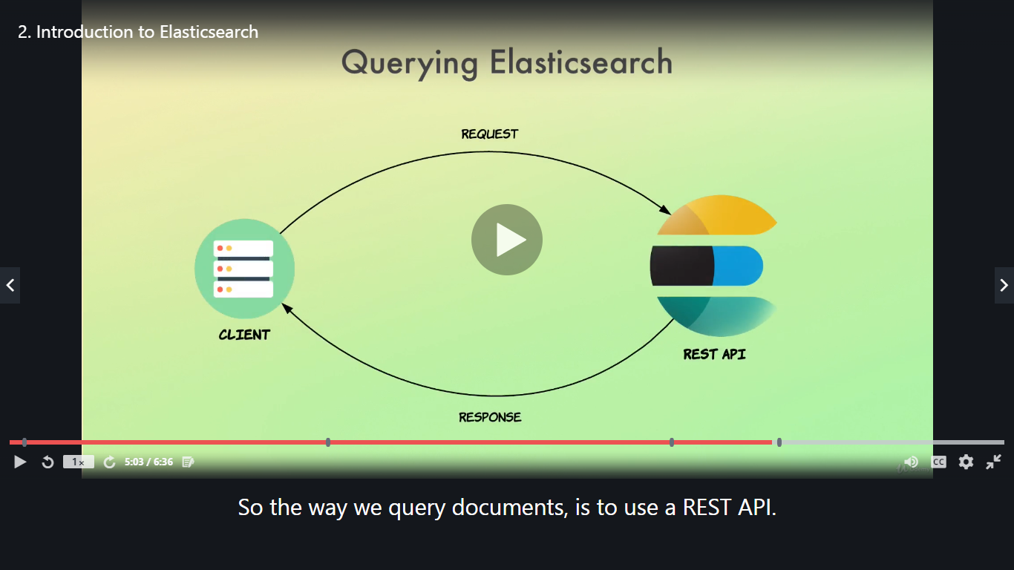
How does Elastic Search work?

Slide 3
How does configure on elastic search?
You have to search on the browser www.elastic.co.
Click on get started
Login
The Create deployment.
The setup your deployment.
You will get the username and password.
Select the elastic search and open the login windows .after that open elastic search dev tools.

Slide 4
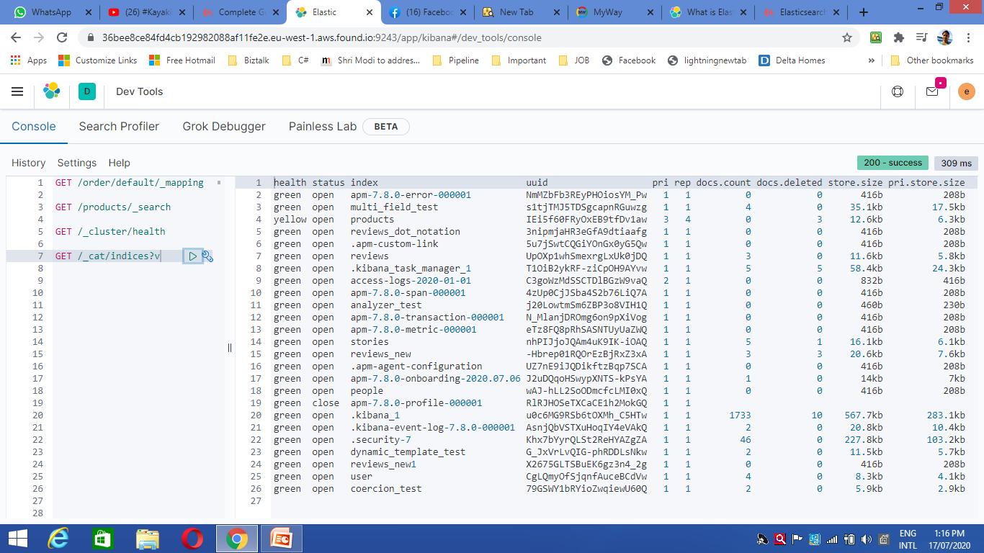
Example for index..

